Slide 1
Formal Semantics of Programming Languages Introduction

Slide 2
Programming Languages
A fundamental field in computer science
As classic as OS and Architectures
SOSP: 1967；ISCA: 1973；POPL: 1973
Old, but still very active
Many important research problems
New languages keep showing up
Rust, Go, Scala, F#, R, Matlab, Python, Kotlin, Julia, Swift, Typescript, Libra, …

Slide 3
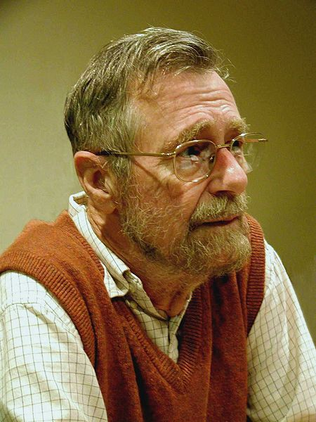
Programming Languages
Computer Science is no more about computers than astronomy is about telescopes.
Edsger W. Dijkstra
How about PL then?

Slide 4
Programming Languages
PL research is broader than designing and implementing new languages. To me, a PL researcher is someone who views the programming language as having a central place in solving computing problems. From this vantage point, PL researchers tend to focus on developing general abstractions, or building blocks, for solving problems, or classes of problems. PL research also considers software behavior in a rigorous and general way, e.g., to prove that (classes of) programs enjoy properties we want, and/or eschew properties we don’t. This approach has proven to be very valuable for solving a wide ranging set of problems.
Blog post by Mike Hicks:
What is PL research and how is it useful? - The PL Enthusiast
www.pl-enthusiast.net/2015/05/27/what-is-pl-research-and-how-is-it-useful/

Slide 5
Formal Semantics
To assign mathematical meanings to language contructs & programs
A scientific way to study PL and programming
“developing general abstractions”

Slide 6
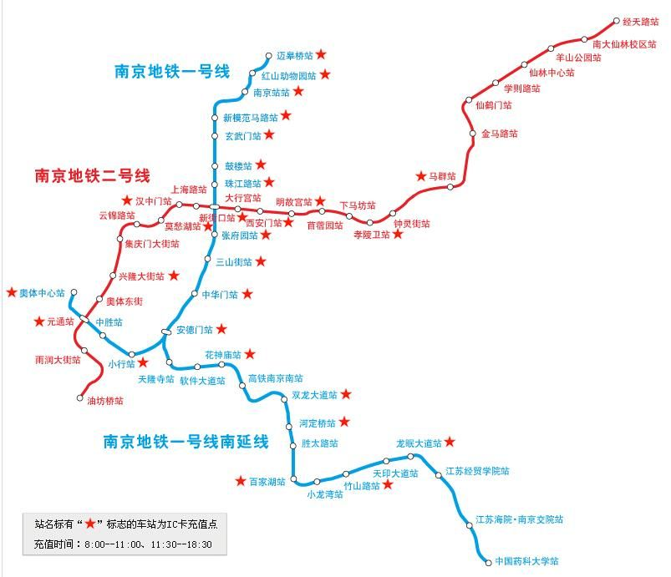
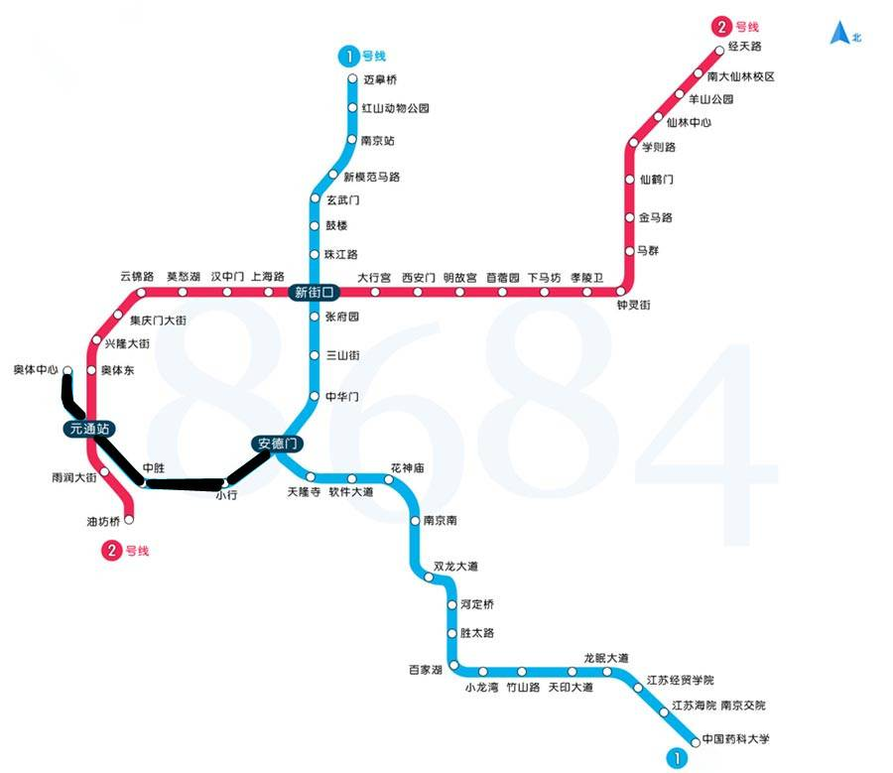
Abstraction

Slide 7
Formal Semantics
To assign mathematical meanings to language contructs & programs
A scientific way to study PL and programming
“developing general abstractions”
“considers software behavior in a rigorous and general way”
More than testing

Slide 8
factorial( n )
{
c = n;
result = 1;
while (c>1) {
result = result * c;
c = c-1;
}
return result;
}
Is it correct?
What do we mean by correctness?

Slide 9
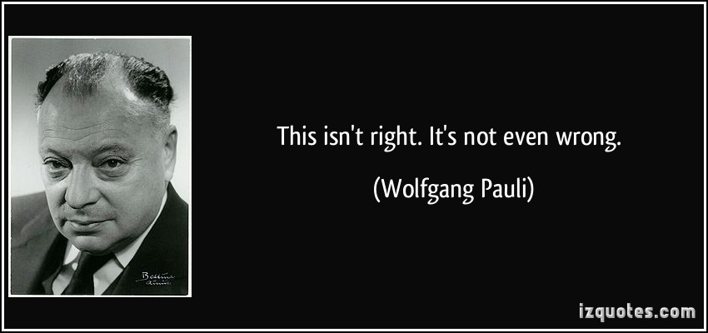
factorial( n )
{
c = n;
result = 1;
while (c>1) {
result = result * c;
c = c-1;
}
return result;
}
Is it correct?
What do we mean by correctness?

Slide 10
{ n ≥ 0 }
factorial( n )
{
c = n;
result = 1;
while (c>1) {
result = result * c;
c = c-1;
}
return result;
}
{ result = n!/c!}
{ result = n!/c! ∧ c=1}
{ result = n! }

Slide 11
We’ll try to answer question like:
How to describe meanings of programs?
How to describe properties of programs?
How to reason about programs?
How to tell if two programs have the same behaviors or not?
How to design a new language?

Slide 12
Why take this course?
Software reliability and security are the biggest problems faced by the IT industry today!
You are likely to worry about them in your future job!

Slide 13
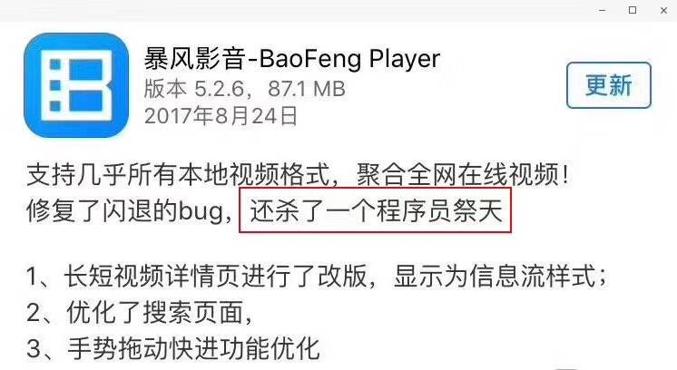


Slide 14
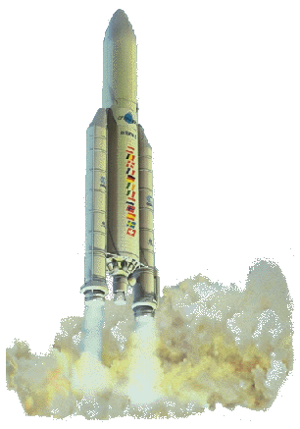
Arianne 5
40 seconds into its flight it veered off course and exploded.
“Conversion of a 64bit integer into a 16bit signed integer leads to an overflow.”
This picture become quite popular in talks on software reliability
On June 4, 1996, the Arianne 5 took off on its maiden flight.

Slide 15
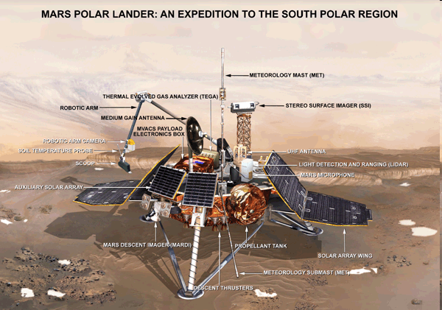

“Better, Faster, Cheaper”
In 1999, NASA lost both the Mars Polar Lander and the Climate Orbiter.
Later investigations determined software errors were to blame.
Orbiter: Component reuse error.
Lander: Precondition violation.

Slide 16
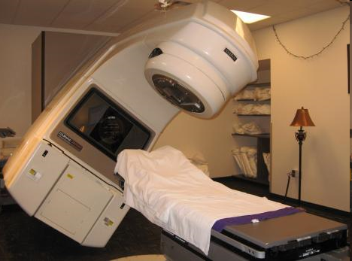
Therac-25
From 1985-1987, 6 patients were killed or seriously injured as a result of overdosed radiation (100 times of the intended dose) by Therac-25, a radiation treatment facility.
The problem was due to a subtle race
condition between concurrent processes.

Slide 17
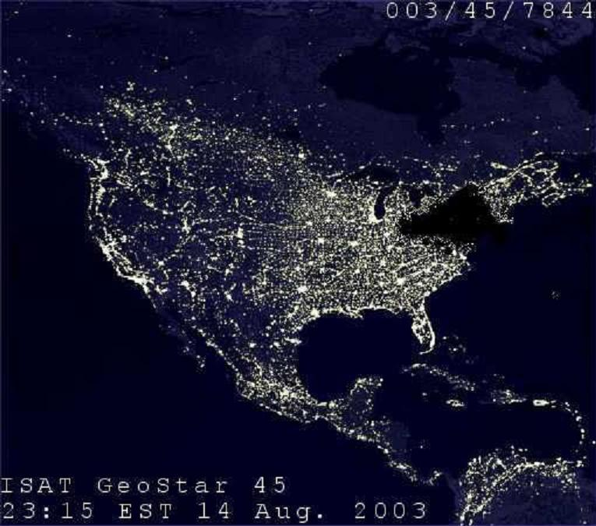
Northeast blackout, 2003
A widespread power outage that occurred throughout parts of the Northeastern and Midwestern United States and Ontario, Canada on Thursday, August 14, 2003
Race conditions in GE Energy's Unix-based XA/21 energy management system caused alarm system failure.

Slide 18
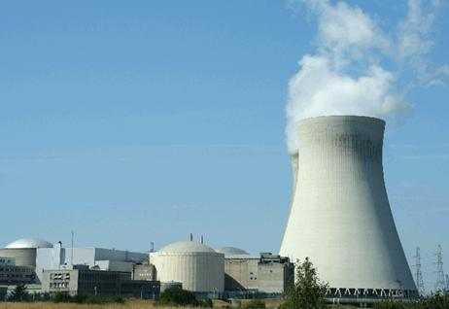
Now think of viruses and Trojan Horses
Stuxnet is used to attack the nuclear power station in Iran in 2010.
The virus took advantage of 4 undeclared bugs in windows to take over the system.

Slide 19
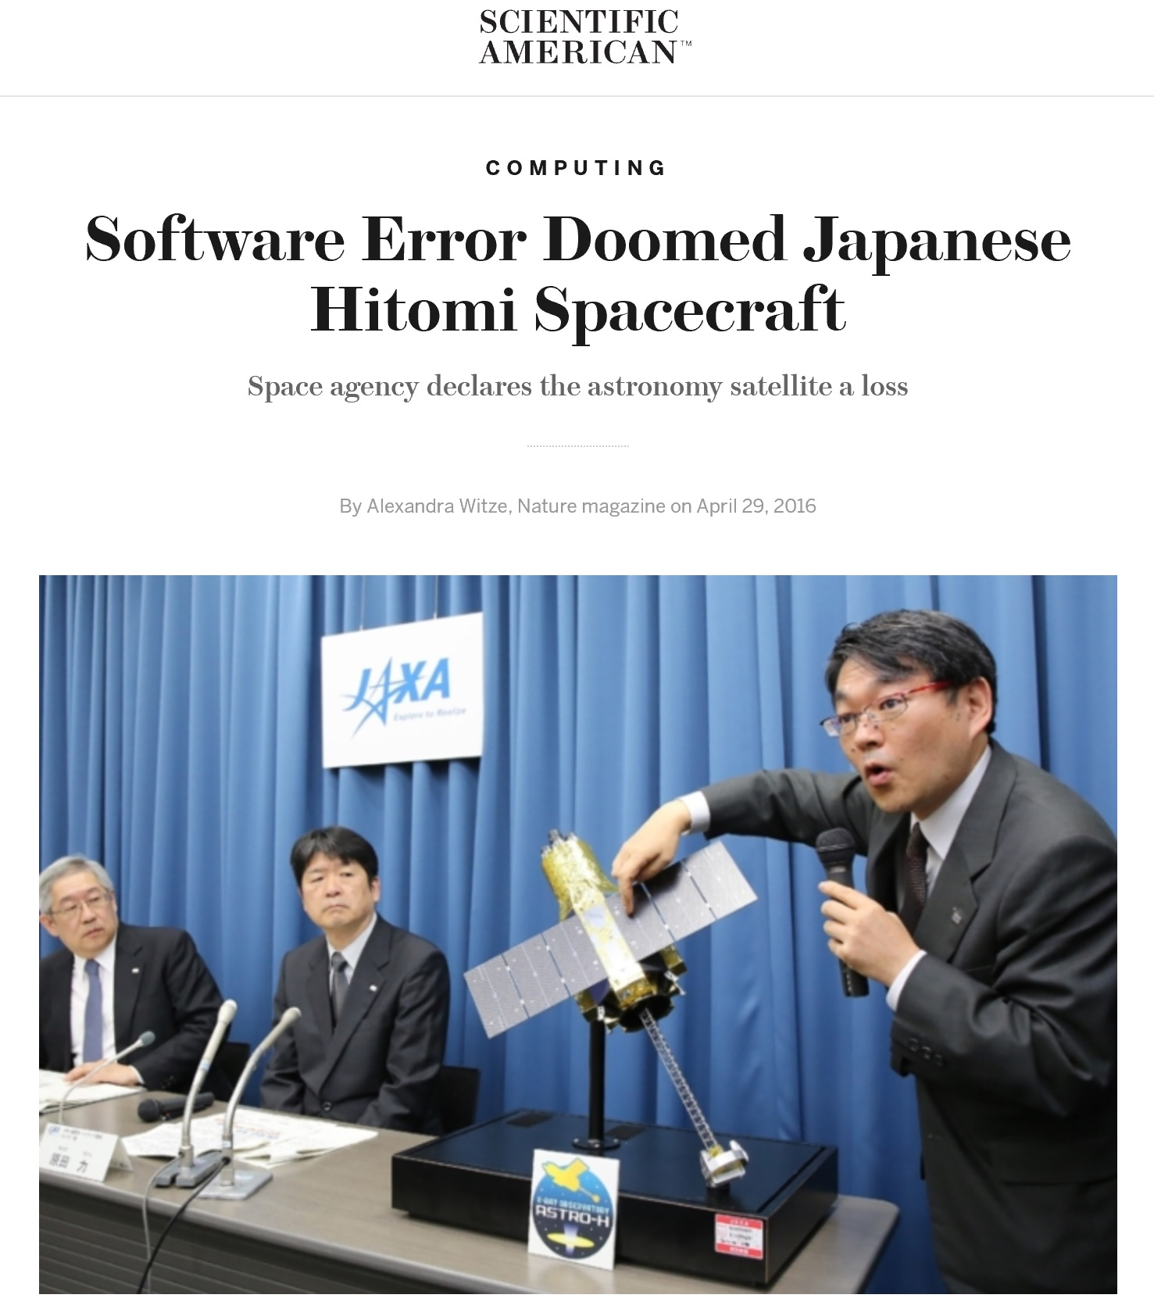
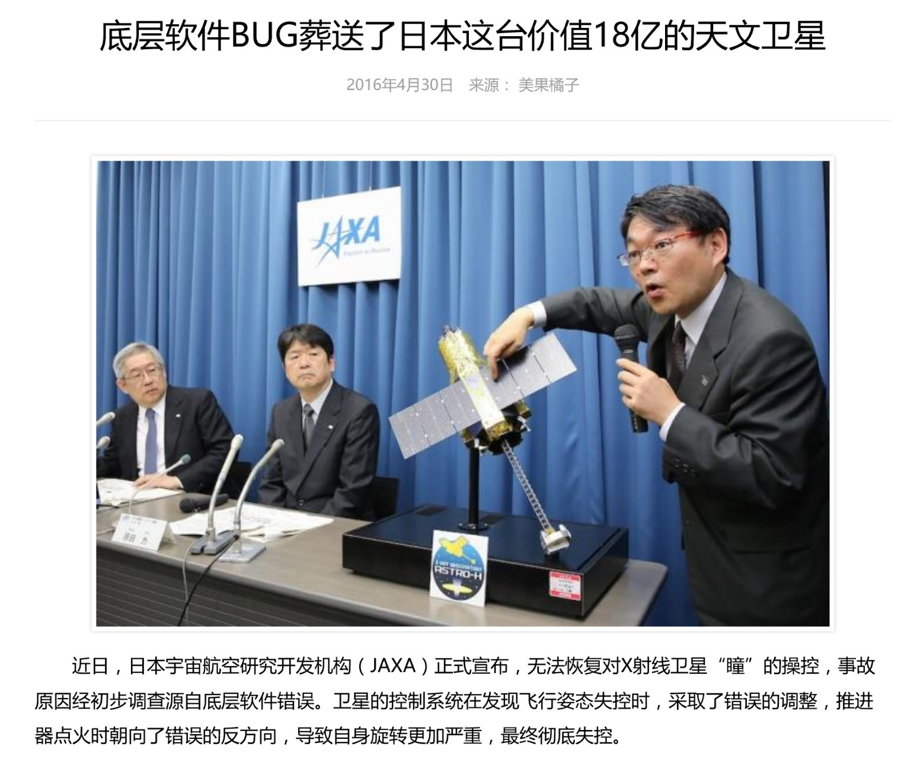
Notes:
http://hackaday.com/2016/05/02/software-update-destroys-286-million-japanese-satellite/
http://www.scientificamerican.com/article/software-error-doomed-japanese-hitomi-spacecraft/?print=true
http://www.wanhuajing.com/d409485

Slide 20
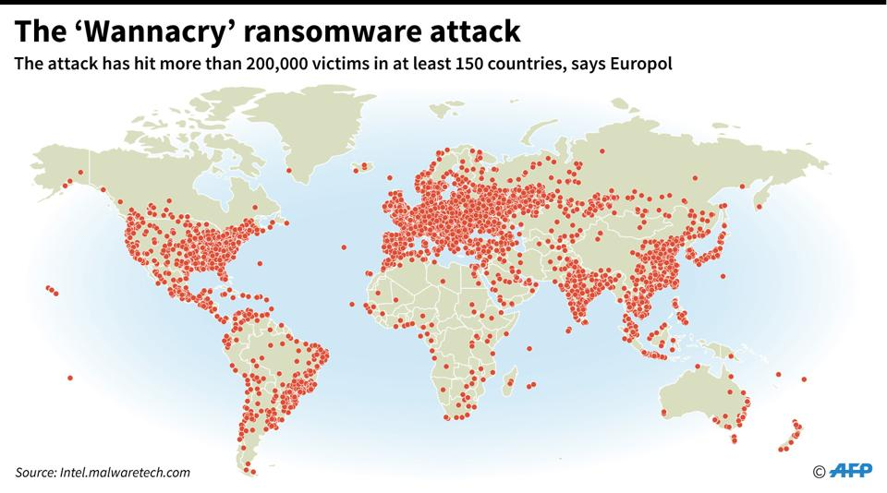
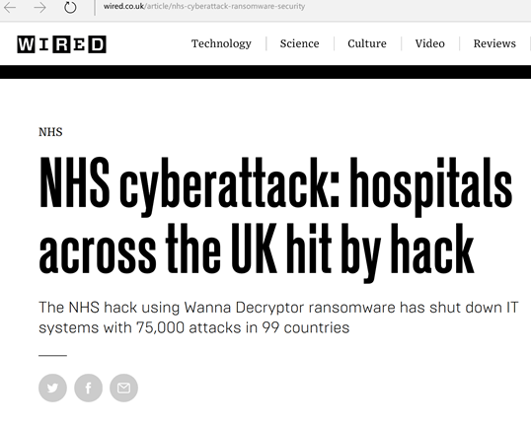
2017年5月Wannacry勒索软件攻击
利用Windows操作系统的缺陷

Slide 21
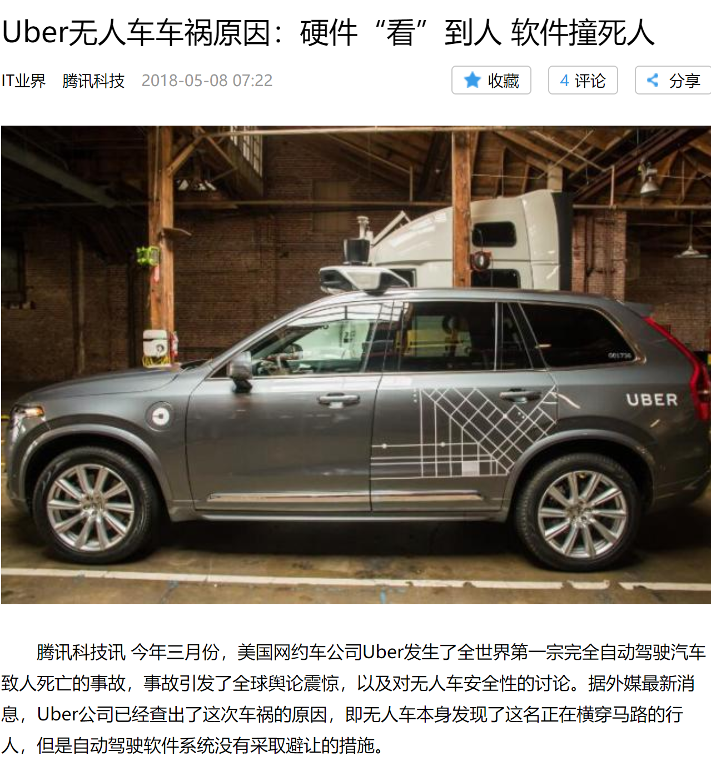
“无人车本身发现了这名正在横穿马路的行人，但是自动驾驶软件系统没有采取避让的措施。”

Slide 22
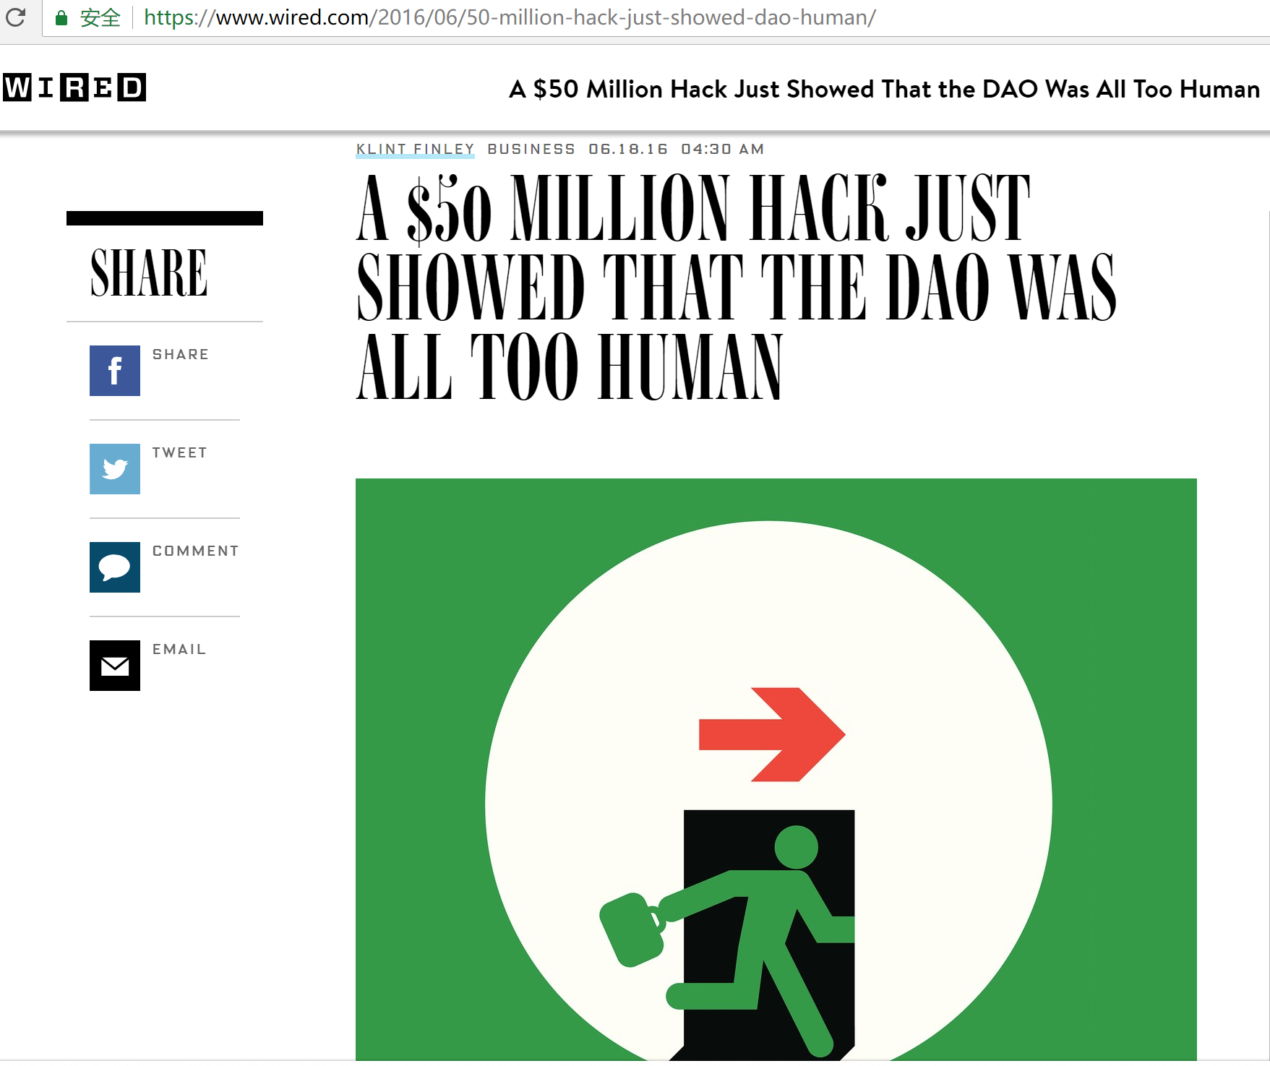
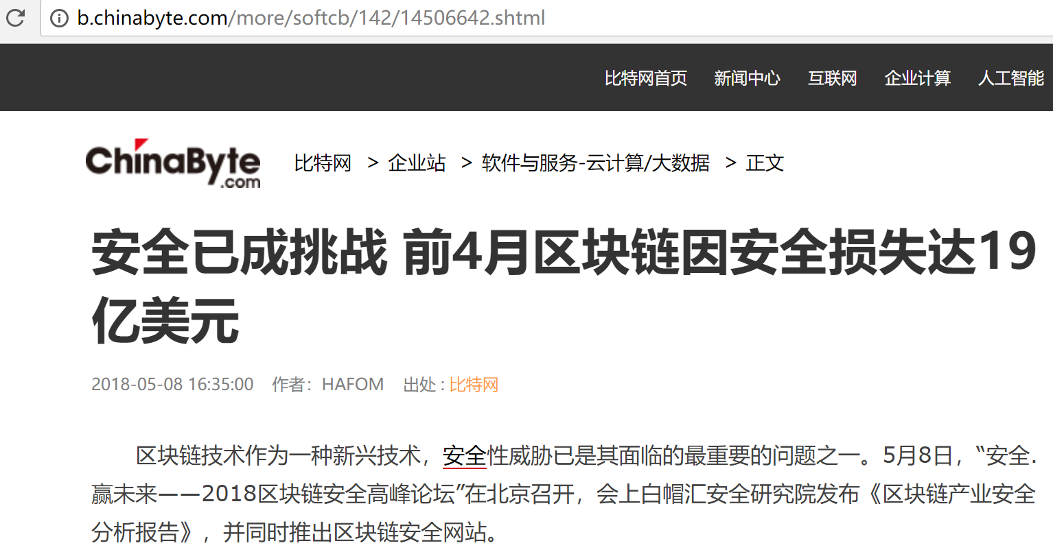

Slide 23
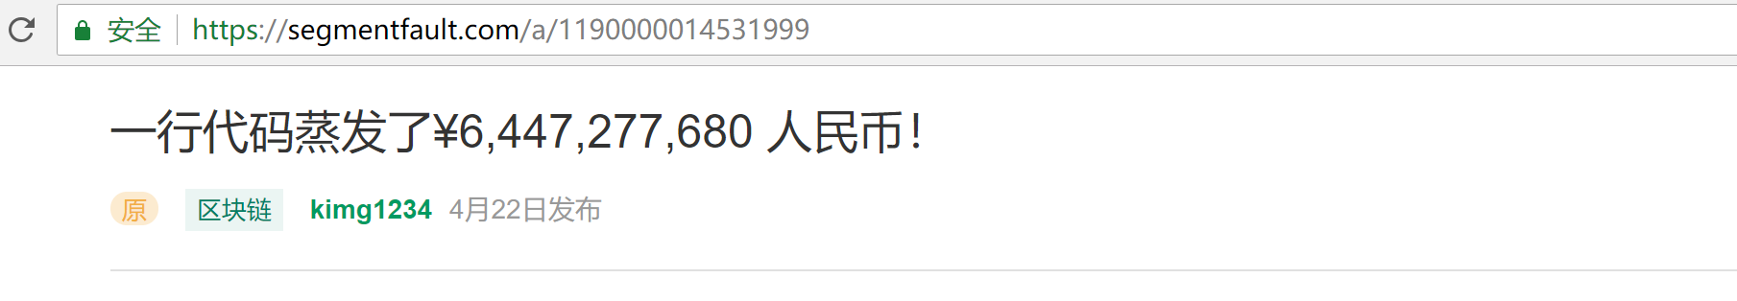
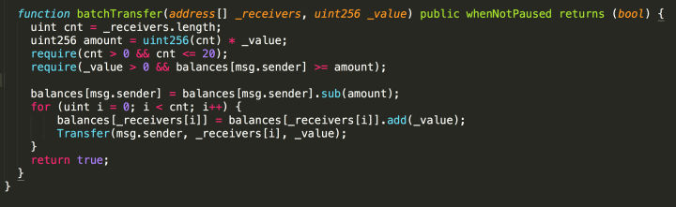
uint256 amount = uint256(cnt) * _value

Slide 24
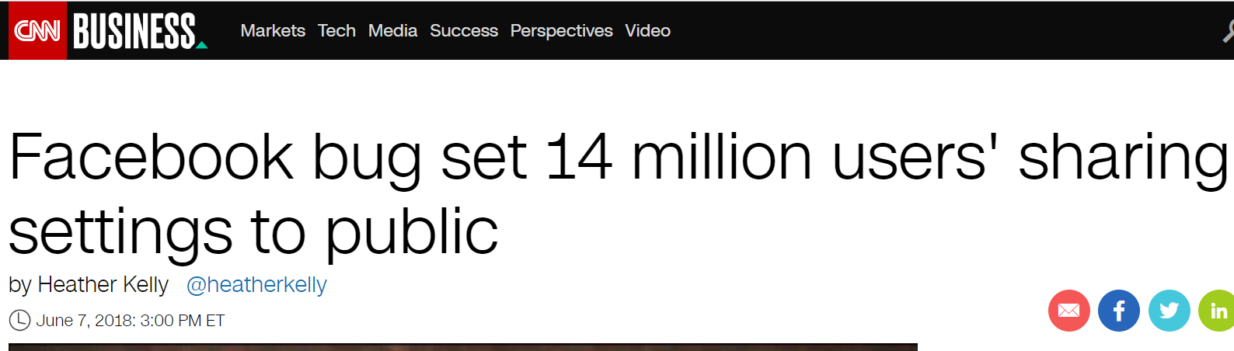

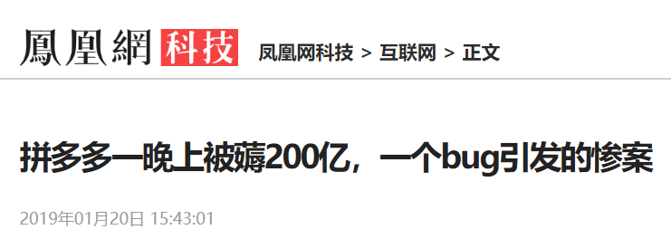
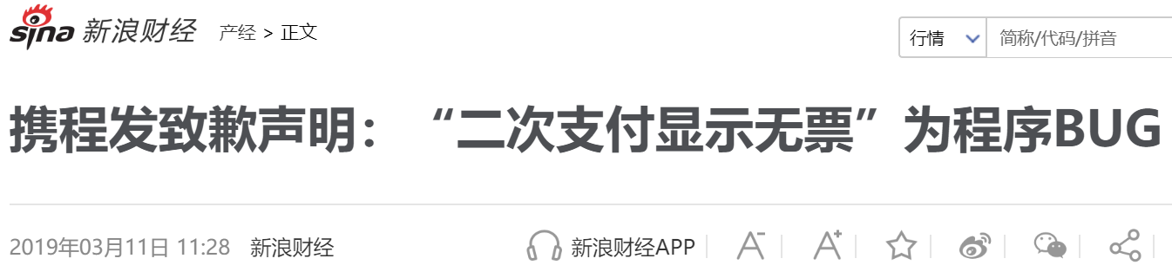
Facebook软件漏洞导致1400万用户私密帖子被公开

Slide 25
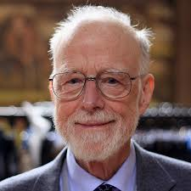
Bug-Free Software?
A grand challenge for computer scientists
Posed since 1960’s
Significant progress, but still challenging
Great practical implication
Software bugs cause the loss of 59.6 billion US dollars each year (0.6% GDP)
2002 report from NIST
“Null References: The Billion Dollar Mistake” - Tony Hoare

Slide 26
Observations
Failure often due to simple problems “in the details”.
Small theorems about large programs would be useful.
Need clearly specified interfaces and checking of interface compliance.
Better languages would help!

Slide 27
New Challenges
Software is becoming more complex nowadays:
Multi-core software
Concurrency
Embedded software
Limited resources
Distributed and cloud computing
Network environment
Ubiquitous computing and Internet of Things

Slide 28
测试的局限性
工程中广泛应用，并且有效
简单、容易自动化
无法保证没有bug
在并发（多核/网络）下面作用有限
Testing shows the presence, not the absence of bugs.
Edsger W. Dijkstra

Slide 29
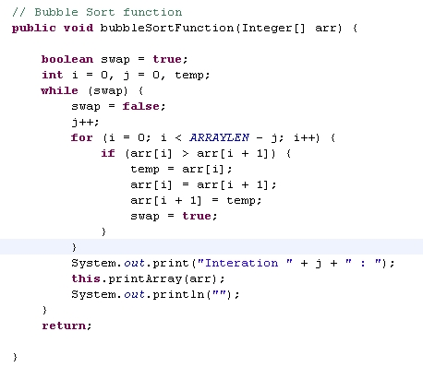
测试的局限性
Bubble Sort
3 5 1 4 2
1 2 3 4 5
✓
3 4 1 2 5
1 2 3 4 5
✓
3 1 2 5 4
1 2 3 4 5
✓
…
…
无法遍历所有可能，因此不能肯定永远正确

Slide 30
测试的另一局限
测试并发程序：发现的bug难以重现
线程1
线程2
…
+
=
并发程序
各种可能的执行
每一次运行同一个并发程序，都可能会产生不同的结果

Slide 31
Limitation of testing – Northeast blackout, 2003
We test exhaustively, we test with third parties, and we had in excess of three million online operational hours in which nothing had ever exercised that bug. I’m not sure that more testing would have revealed that. Unfortunately, that’s kind of the nature of software… you may never find the problem. I don’t think that’s unique to control systems or any particular vendor software.
-- Mike Unum, manager at GE Energy
Race conditions in GE Energy's Unix-based XA/21 energy management system caused alarm system failure.

Slide 32
Opportunities
High assurance / reliability depends fundamentally on our ability to reason about programs.
The opportunities for new languages as well as formal semantics, type theory, computational logic, and so on, are great.

Slide 33
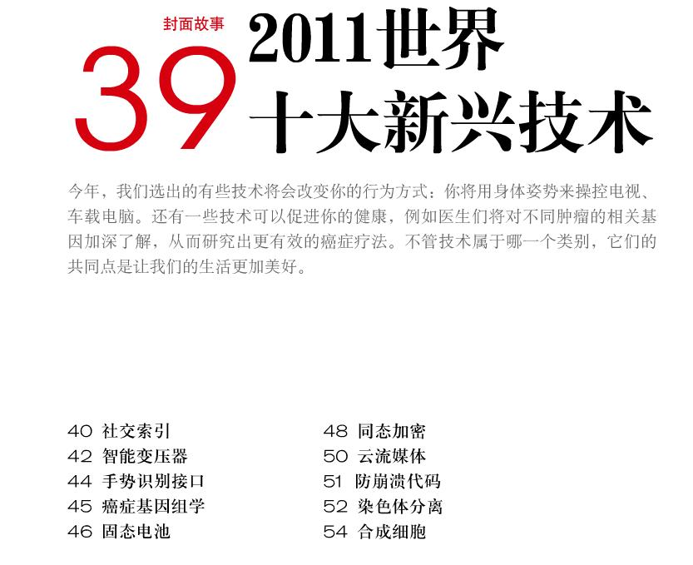

防崩溃代码

Slide 34
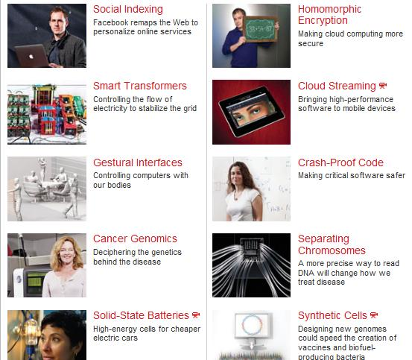
Crash-Proof Code
英文版：Technology Review, 2011(6), MIT Press
http://www.technologyreview.com/tr10/

Slide 35
Report on Crash-Proof Code
Verification of the seL4 OS kernel
Done by the Australian group at NICTA
Give mathematical proof showing the kernel would never crash
How to do this mathematically?
How to define “crash”?
How to prove the system is “crash-proof”?
We will answer the questions in this course

Slide 36
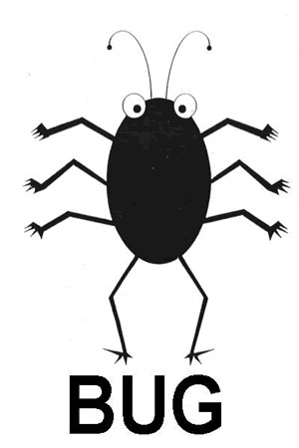
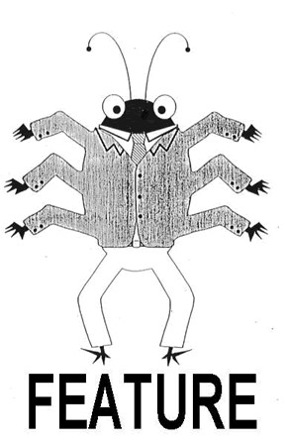
How to define “crash”?

Slide 37
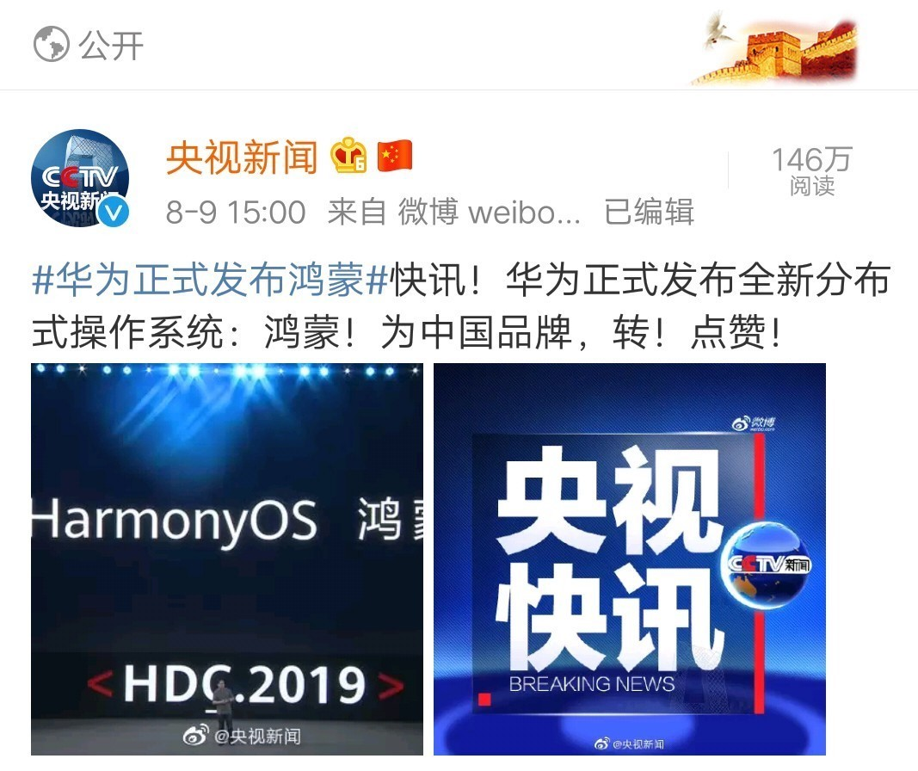

Slide 38
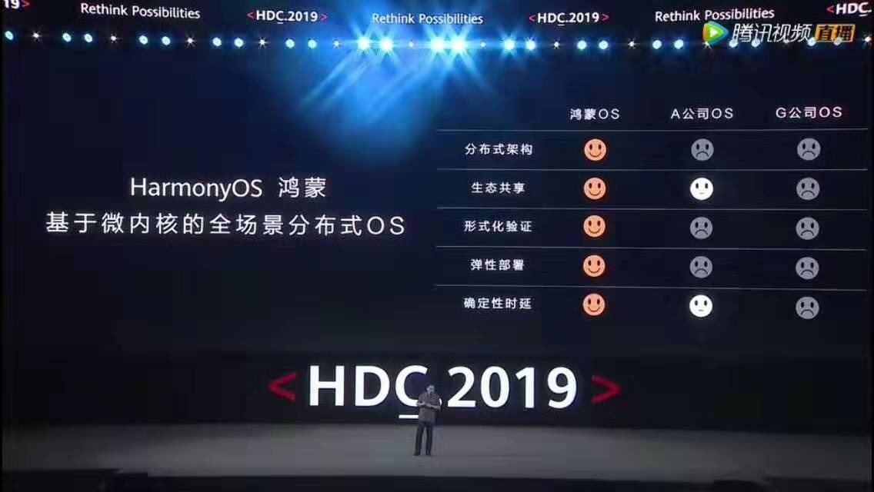
鸿蒙发布会现场，余承东介绍鸿蒙的技术特性
形式化验证

Slide 39
Why take this course
Software reliability and security are the biggest problems faced by the IT industry today! You are likely to worry about them in your future job!
It will give you an edge over your competitors: industry and most other schools don’t teach this.
It will improve your programming skills – because you will have a better appreciation of what your programs actually mean.
You will be better able to compare and contrast programming languages, or even design your own.
It’s intellectually deep: there’re many challenging and hot research problems.

Slide 40
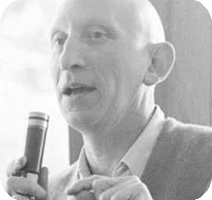
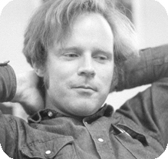
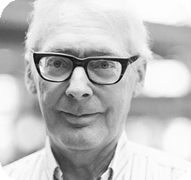
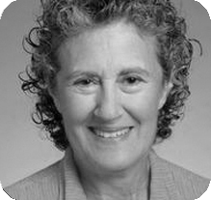
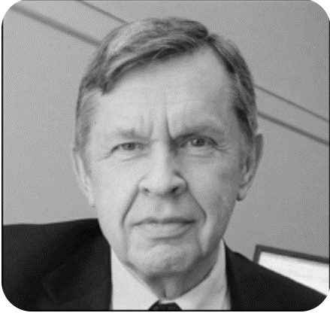
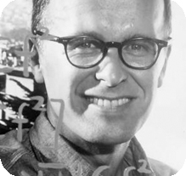
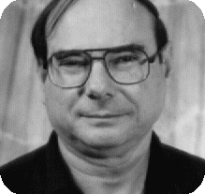
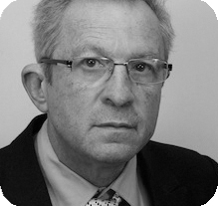
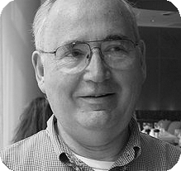
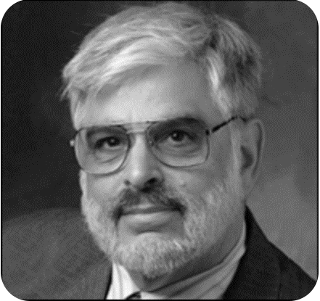
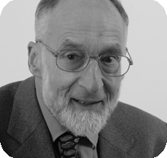
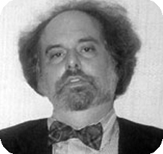
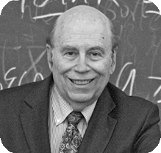
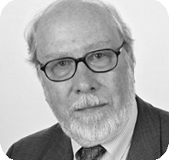
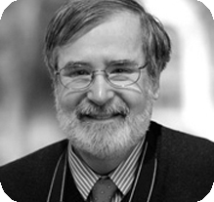
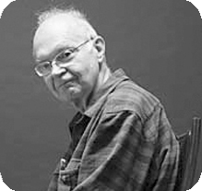
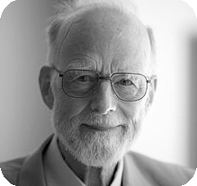
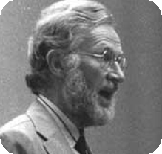
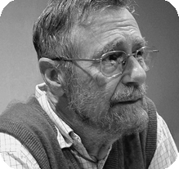
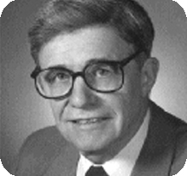


22位
图灵奖得主

Slide 41
{ f ∈ [1..N] ⟶ [1..N] | ∀ y ∈ [1..N]. ∃ x ∈ [1..N]. f(x)=y }

Slide 42
Course Overview

Slide 43
Goals of the Course
Survey existing language features
What they mean? What they do? How they compare?
Methods to define behaviors of programs
Operational/Denotational/Axiomatic Semantics
Methods to reason about properties of programs
Define and prove “correctness” of programs
Building “crash-proof” or “bug-free” software

Slide 44
Preliminary Syllabus
Introduction, Coq, Mathematical foundations
Lambda calculus
Untyped, simply-typed
Imperative languages
Operational semantics, (denotational), Hoare logic
C-like pointer programs and separation logic
Concurrent languages and process calculi
Advanced Topics:
Concurrency logic (CSL, RG)
Compiler verification & CompCert

Slide 45
References
Benjamin C. Pierce, et al. Software Foundations.
https://softwarefoundations.cis.upenn.edu/
John C. Reynolds. Theories of Programming Languages. Cambridge University Press.
Hanne Riis Nielson, Flemming Nielson. Semantics with Applications: A Formal Introduction.
Robert Harper. Practical Foundations for Programming Languages. http://www.cs.cmu.edu/~rwh/pfpl/2nded.pdf

Slide 46
Course Requirements
Grading
40% attendance and homework
60% final exam
Class attendance is highly recommended
Homework: Problem sets
No cheating!
No late (unless special reasons provided)

Slide 47
Course Webpage:
https://cs.nju.edu.cn/hongjin/teaching/semantics/
QQ Group: 710976220
Lecture notes, homework, notifications and reading materials will all be posted on the course webpage.
You can ask questions in QQ group, or email me your questions.
Please pay attention to the updates.

